Slide 1
Quantitative Verification of Neural Networks and Its Security Applications
Teodora Baluta
Joint work with Shiqi Shen, Shweta Shinde, Kuldeep S. Meel, Prateek Saxena
Group Seminar
12th May, 2020

Slide 2

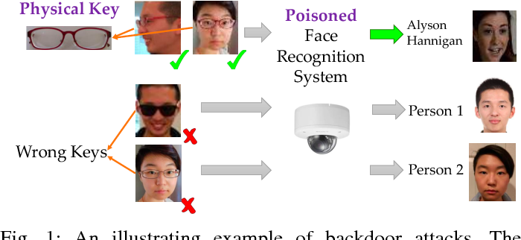
Fairness
Robustness
Trojan Attack
Concerns with Machine Learning Systems
Verifying Properties of Neural Networks

Slide 3



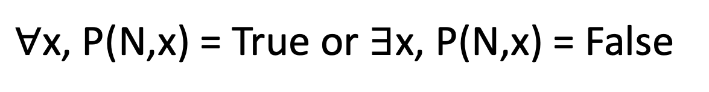
Verifying Properties of Neural Networks
Safety
Robustness
Property P
Neural Net N
VERIFIER
True/False
$∀$x, P(N,x) = True or $∃$x, P(N,x) = False

Slide 4
Fairness Example
How fair is the neural network?
Do two individuals with different sex but with the same income, education, etc. get the same prediction?

Slide 5
Fairness Example
x₁
male
female
x₂
PhD
Approved
Denied
….
We found a counterexample!
Unlikely to be perfectly fair due to stochastic training.
Then how fair is the neural net?
x₁₀₀
Singapore
Input Features
Trained Neural Net

Slide 6

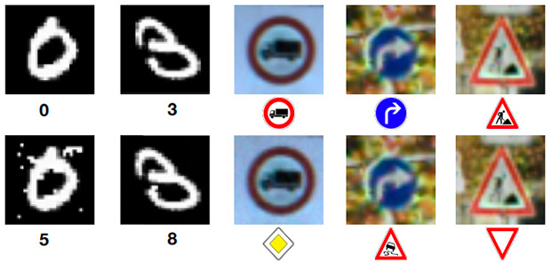
Quantitative Verification of Neural Networks
Fairness
Robustness
Trojan Attack
Property P
Neural Net N
QUANTITATIVE
VERIFIER
How often does P hold for N?

Slide 7
Contributions
Novel notion of quantitative verification for neural networks.
Sound procedure to produce estimates of how often a property holds.
Instantiated efficiently for binarized neural networks and 3 security applications in a tool called NPAQ.

Slide 8
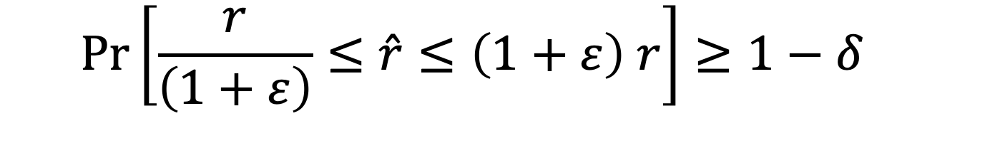
Quantitative Verification Soundness
Probably Approximately Correct (PAC)-style guarantees or $(ε,δ$)-guarantees
Estimate
Ground
Truth
$$\operatorname{Pr}\left[\frac{r}{\left(1+ε\right)}≤\hat{r}≤\left(1+ε\right) r\right]≥1−δ$$
Error Tolerance
Confidence

Slide 9
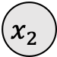


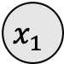
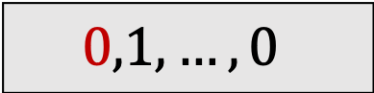


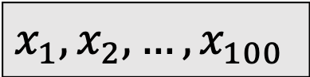
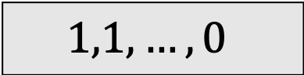


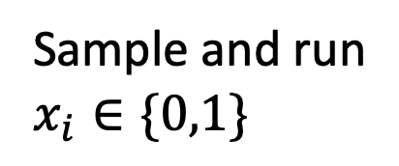



How to Quantify?
Sample and run
$$x_{i}∈\{0,1\}$$
“Black-box”
Neural Net
$$0,1,…,0$$
$$1$$
$$x_{1}$$
$$0$$
$$1,1,…,0$$
$$1$$
$$1$$
$$x_{2}$$
Approved
Denied
$$1$$
$$0$$
$$y$$
$$0$$
$$x_{100}$$
$$0$$
$$x_{1},x_{2},…,x_{100}$$
(Binary)
Input Features
Worst case: 2⁹⁹ checks

Slide 10
From 2⁹⁹ to #SAT
Reduce quantitative verification to a model counting problem (#SAT).
Neural Net N
Property P
Specification φ
Model Counting
Estimate #(P holds for N)

Slide 11
Complexity of the Problem
Counting is a hard problem (#P-complete).
Even approximate model counting is NP-hard.
But existing approximate counting tools for #SAT have seen great improvements in recent years.

Slide 12


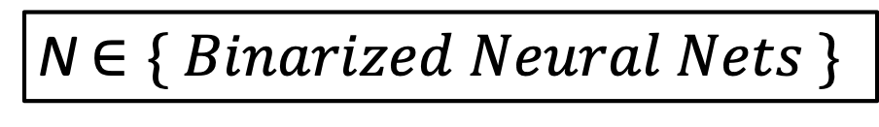
Approach
To obtain a specification we need to take a look inside the black-box
Neural Net N
Property P
N $∈\{ Binarized Neural Nets \}$
Specification φ in CNF
Approximate Model Counting
Approximate Model Counting with (ε, δ)-guarantees
The estimate is within user-specified error and confidence
Specification in CNF
Estimate #(P holds for N)

Slide 13
Obtaining the Specification for BNNs
Binarized neural nets (BNNs) are feed-forward neural nets with:
Weights are -1 or 1
Binarization activation (sign function)

Slide 14
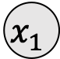
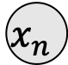
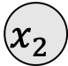
Internal Block
Argmax
Linear Layer
Output Block
Batch Normalization Layer
Linear Layer
Binarization
$$x_{1}$$
ARGMAX
$$x_{2}$$
$$x_{n}$$
Output Block
Internal Block
Binarized Neural Networks
(Binary)
Input Features

Slide 15
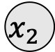

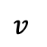

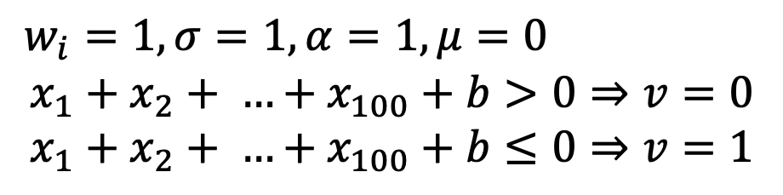
Encoding to CNF
Internal Block
$$v$$
$$x_{1}$$
ARGMAX
$$x_{2}$$
$w_{i}=1, σ=1, α=1,μ=0$
$$x_{1}+x_{2}+ …+x_{100}+b>0⇒v=0$$
$$x_{1}+x_{2}+ …+x_{100}+b≤0⇒v=1$$
$$x_{100}$$
Output Block
Internal Block

Slide 16
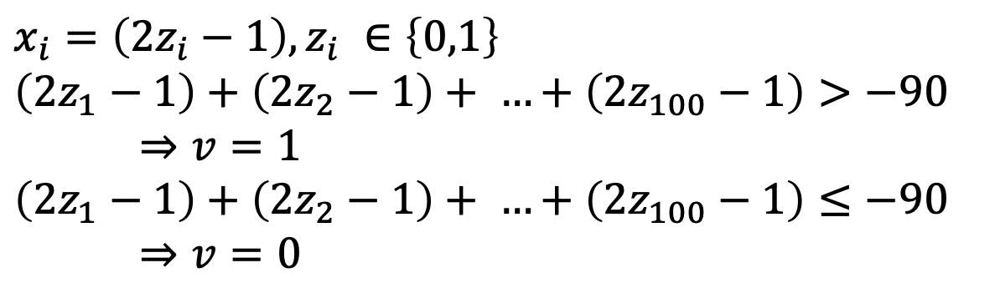
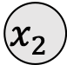
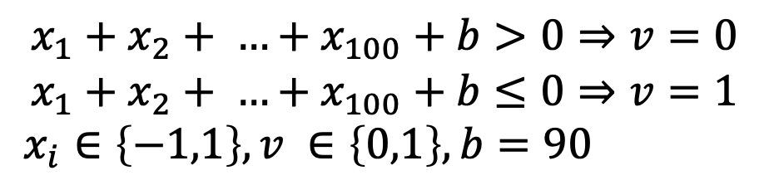


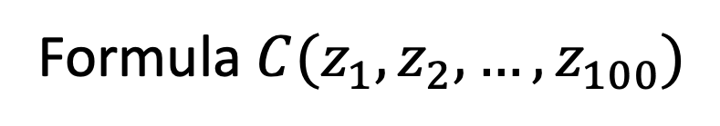

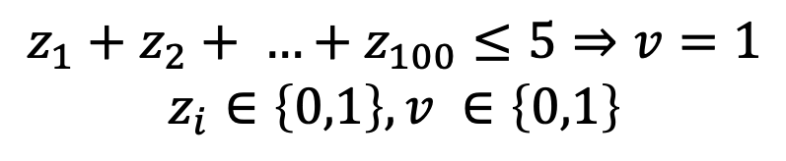
Encoding to CNF
$$x_{1}$$
$$v$$
$$x_{1}+x_{2}+ …+x_{100}+b>0⇒v=0$$
$$x_{1}+x_{2}+ …+x_{100}+b≤0⇒v=1$$
$x_{i}∈\left\{−1,1\right\}, v ∈\left\{0,1\right\}, b=90$
$$x_{2}$$
Encode
Convert to boolean
$$x_{100}$$
$$x_{i}=\left(2z_{i}−1\right),z_{i} ∈\left\{0,1\right\}$$
$$\left(2z_{1}−1\right)+\left(2z_{2}−1\right)+ …+\left(2z_{100}−1\right)>−90$$
$⇒v=1$
$$\left(2z_{1}−1\right)+\left(2z_{2}−1\right)+ …+\left(2z_{100}−1\right)≤−90$$
$⇒v=0$
$$z_{1}+z_{2}+ …+z_{100}≤5⇒v=1$$
$$z_{i}∈\left\{0,1\right\}, v ∈\left\{0,1\right\}$$
Formula ${C(z}_{1},z_{2},…, z_{100})$

Slide 17
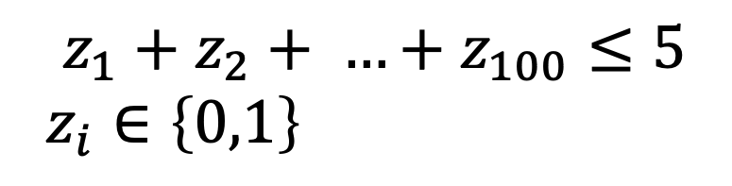
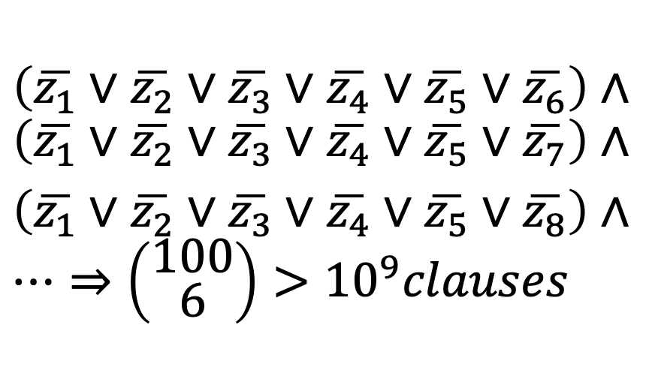
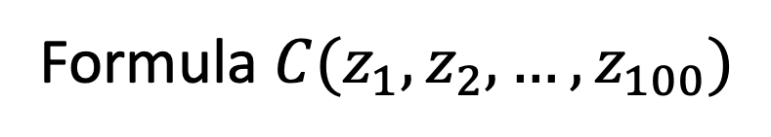
Intractable Encodings
$$\left(\overline{z_{1}}∨\overline{z_{2}}∨\overline{z_{3}}∨\overline{z_{4}}∨\overline{z_{5}}∨\overline{z_{6}}\right)∧$$
$$\left(\overline{z_{1}}∨\overline{z_{2}}∨\overline{z_{3}}∨\overline{z_{4}}∨\overline{z_{5}}∨\overline{z_{7}}\right)∧$$
$\left(\overline{z_{1}}∨\overline{z_{2}}∨\overline{z_{3}}∨\overline{z_{4}}∨\overline{z_{5}}∨\overline{z_{8}}\right)$ $∧…⇒\left({\text{100} \atop \text{6}}\right)>{10}^{9}clauses$
$$z_{1}+z_{2}+ …+z_{100}≤5$$
$$z_{i}∈\left\{0,1\right\}$$
Formula ${C(z}_{1},z_{2},…, z_{100})$
Encoding to CNF with an equivalent formula is intractable.

Slide 18
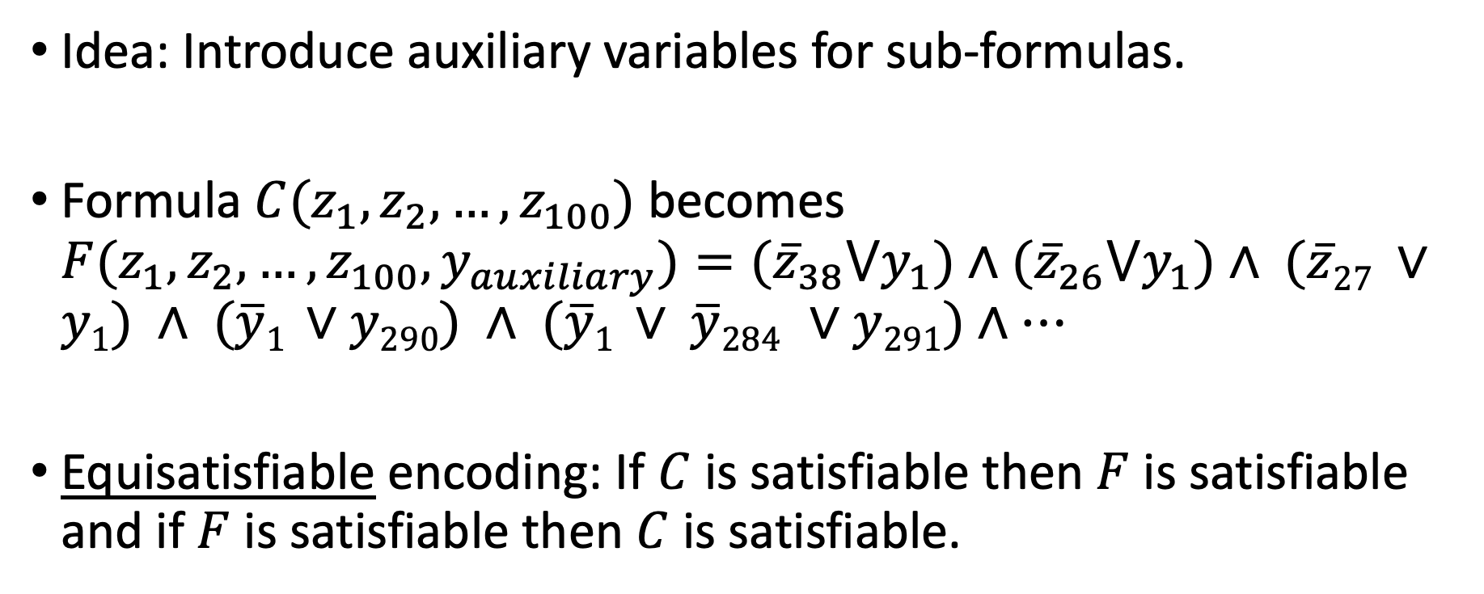
Efficient Encodings
Idea: Introduce auxiliary variables for sub-formulas.
Formula ${C(z}_{1},z_{2},…, z_{100})$ becomes ${F(z}_{1},z_{2},…, z_{100}, y_{auxiliary})=({\overline{z}}_{38}⋁y_{1})∧({\overline{z}}_{26}⋁y_{1})∧\text{ (}\overline{z}\text{27} ∨y\text{1}\text{) }∧\text{ (}\overline{y}\text{1 }∨y\text{290}\text{) }∧ \text{(}\overline{y}\text{1 }∨ \overline{y}\text{284 }∨y\text{291}\text{)}∧…$
Equisatisfiable encoding: If $C$ is satisfiable then $F$ is satisfiable and if $F$ is satisfiable then $C$ is satisfiable.

Slide 19
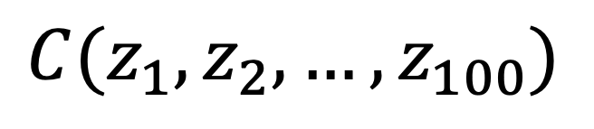
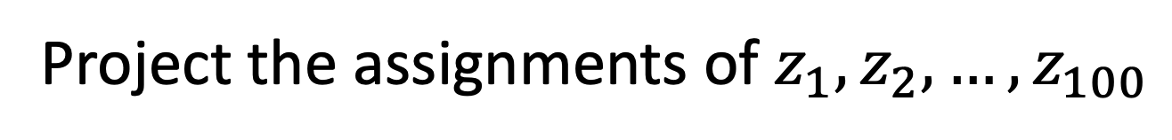
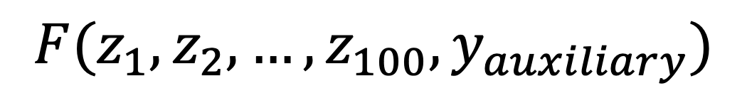
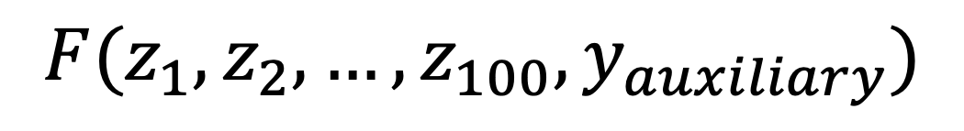
Project the assignments of $z_{1},z_{2},…, z_{100}$
$${F(z}_{1},z_{2},…, z_{100}, y_{auxiliary})$$
$${C(z}_{1},z_{2},…, z_{100})$$
$${F(z}_{1},z_{2},…, z_{100}, y_{auxiliary})$$
Is the count preserved?

Slide 20
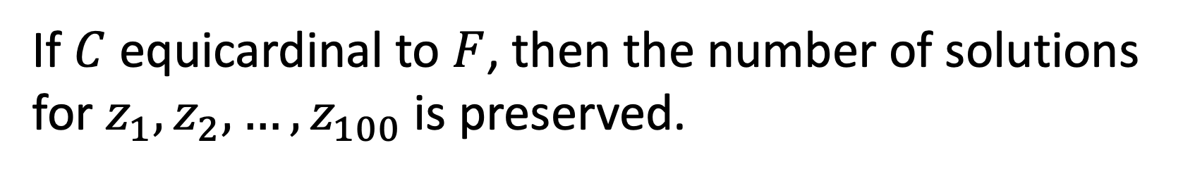
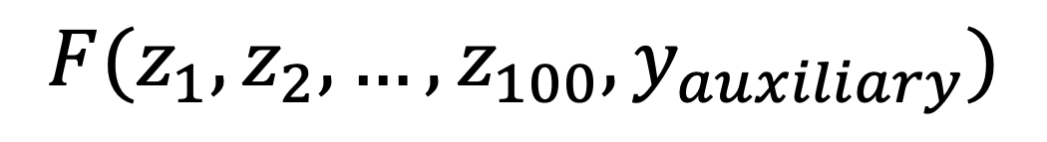
A New Concept: Equicardinality
Project the assignments of $z_{1},z_{2},…, z_{100}$
$${F(z}_{1},z_{2},…, z_{100}, y_{auxiliary})$$
$${C(z}_{1},z_{2},…, z_{100})$$
$${F(z}_{1},z_{2},…, z_{100}, y_{auxiliary})$$
If $C$ equicardinal to $F$, then the number of solutions for $z_{1},z_{2},…, z_{100}$is preserved.

Slide 21
Quantitative Verification in a Nutshell
Neural Net N
Property P
Equicardinal Encodings
Neural Net N and Property P
CNF formula φ
for N and P
Specification φ in CNF
Preserve #solutions
Approximate Model Counting
Approximate Model Counting with (ε, δ)-guarantees
The estimate is within user-specified error and confidence
Estimate #(P holds for N)

Slide 22


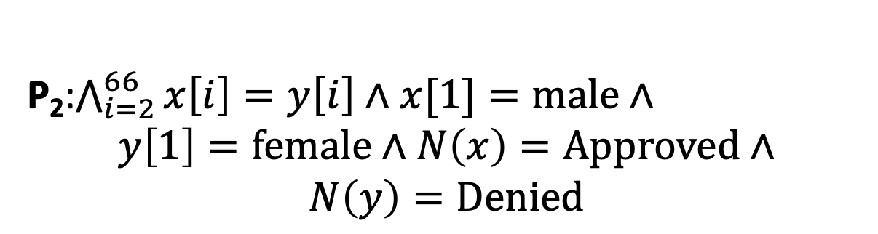
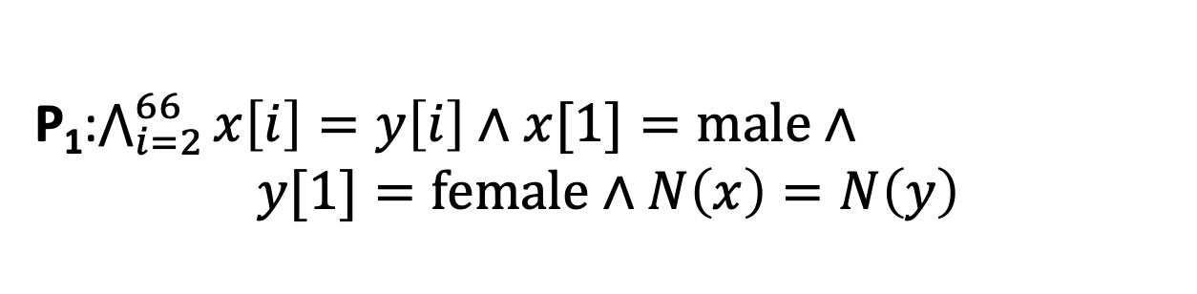
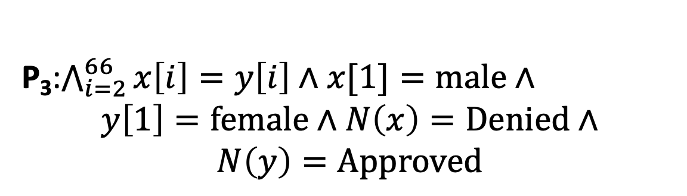
Application I: Fairness
“Can I get a loan?”
P₁:$\bigwedge_{i=2}^{66}{x\left[i\right]=y\left[i\right]∧x[1]=male}∧$
$$y[1]=female∧N\left(x\right)=N\left(y\right)$$
Neural Net N
Training
Deploy
P₂:$\bigwedge_{i=2}^{66}{x\left[i\right]=y\left[i\right]∧x[1]=male}∧$
$$y\left[1\right]=female∧N\left(x\right)=Approved∧$$
$$N\left(y\right)=Denied$$
Big Data
Approved
Fairness
P₃:$\bigwedge_{i=2}^{66}{x\left[i\right]=y\left[i\right]∧x[1]=male}∧$
$$y\left[1\right]=female∧N\left(x\right)=Denied∧$$
$$N\left(y\right)=Approved$$
Data Providers

Slide 23
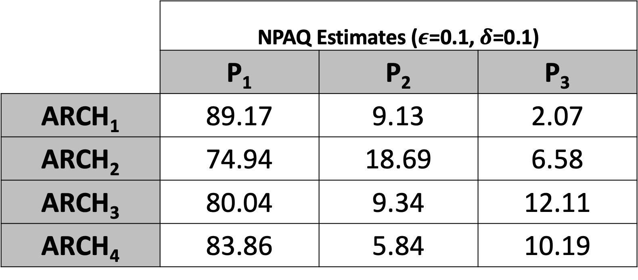
Application I: Fairness
Within 6 hours!
 | _{NPAQ Estimates (}$ε$_{=0.1,} $δ$_{=0.1)}
 | P₁ | P₂ | P₃
ARCH₁ | 89.17 | 9.13 | 2.07
ARCH₂ | 74.94 | 18.69 | 6.58
ARCH₃ | 80.04 | 9.34 | 12.11
ARCH₄ | 83.86 | 5.84 | 10.19
 | P₁ | P₂ | P₃
ARCH₁
ARCH₂
ARCH₃
ARCH₄
Results are a ratio of the inputs satisfying P₁, P₂, P₃

Slide 24
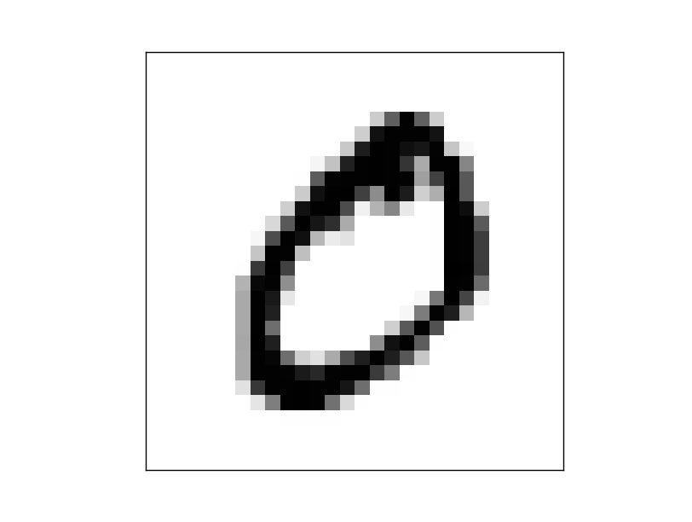


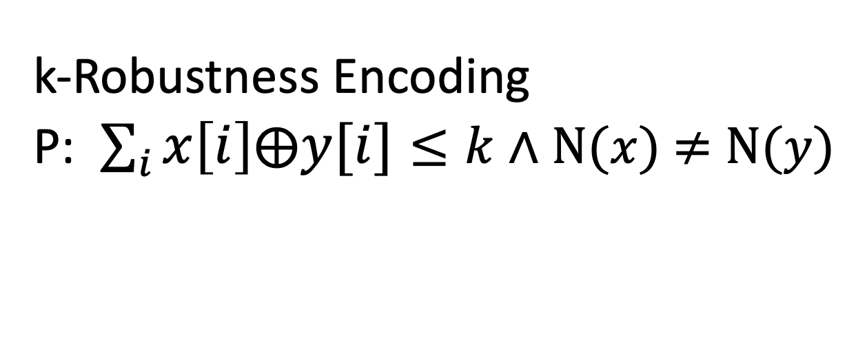
Application II: Robustness
MNIST
“Classify this for me”
Deploy Model
Neural Net N
Training
Deploy
Big Data
Label 0
Label 8
Robustness
k-Robustness Encoding
P: $\sum_{i}{x\left[i\right]⨁y[i]≤k}$ $∧$ N($x$) $≠$N($y$)
Data Providers

Slide 25
Application II: Robustness
Plain
BNN
ARCH₁, ARCH₂, ARCH₃, ARCH₄
_{Defense 1}
_{Defense 2}
Defense₁
BNN
Defense₂
BNN
Which BNN has less adversarial examples?
Notes:
We take the 4 different models and can ask which BNN has less adversarial samples.

Slide 26
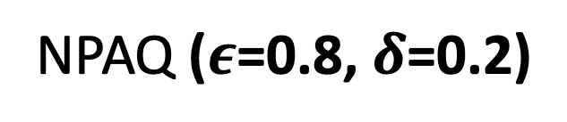
Application II: Robustness
NPAQ ($ε$=0.8, $δ$=0.2)
ARCH₁
ARCH₂
ARCH₃
ARCH₄

Slide 27

Application III: Trojan Attack
MNIST
“Classify this for me”
Deploy Model
Deploy Model
Training
Deploy
Big Data
Label 0
Label 8
Insert Trojan
Poisoning
Data Providers
Data Providers

Slide 28
Application III: Trojan Attack
Within 24 hours
Target Label | Epoch 1 |  | Epoch 10 |  | Epoch 30
 | NPAQ | Test Acc | NPAQ | Test Acc | NPAQ | Test Acc
4 | 9.77 | 66.80 | 19.14 | 83.18 | 2.69 | 69.99
Target Label | Epoch 1 |  | Epoch 10 |  | Epoch 30
 | NPAQ | Test Acc | NPAQ | Test Acc | NPAQ | Acc
4
Notes:
Replace this table with something similar to fairness

Slide 29
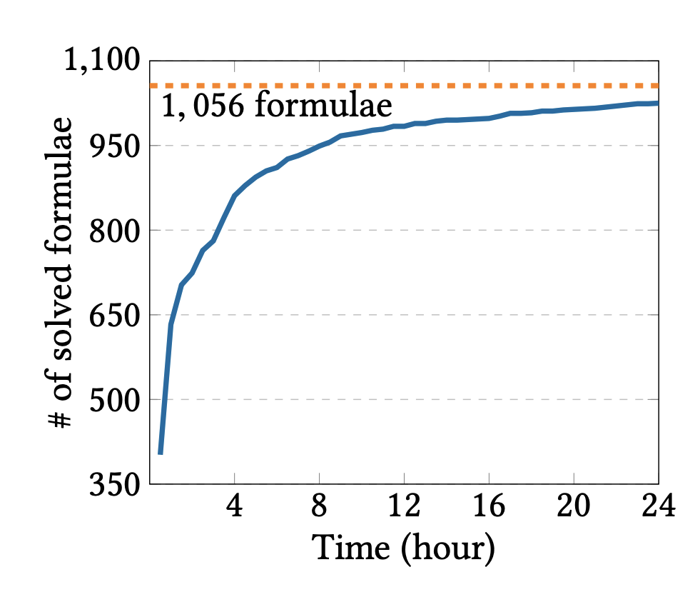
Performance Evaluation
97.1%
89.5%
NPAQ can solve most of the formulae in 24 hours.
Notes:
Given the practical usage of our approach we also measure how efficient our approach.

Slide 30
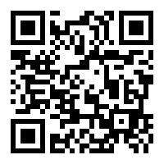
Take-Away & Future Work
Tool Page
Novel notion of approximate quantitative verification.
Sound and efficient in terms of neural network parameters.
Show application to fairness, robustness and trojan attack success.
NPAQ can scale for BNNs with 50,000 parameters.
Future work: extend to other types of network and improve scalability.
Thank you!

